Slide 1
Programming I – RIN
Computer... I – MA
Event driven programming
13

Slide 2
Overview
What is event driven programming?
AWT
Swing
Okvir – Frame
Components
Drawing
Events and listeners
Layout manager
Programming I
© Branko Kavšek, Jernej Vičič
13

Slide 3
GUI – Graphical User Interface
Nice figures that talk to the user
Well a little bit more.
Programming I
© Branko Kavšek, Jernej Vičič
13

Slide 4
AWT
AWT - Abstract Window Toolkit.
AWT is part of the Java Foundation Classes (JFC)
It is a standard set of instructions (API) that enable GUI development
AWT is a set of wrappers around standars windowsin system calls
Programming I
© Branko Kavšek, Jernej Vičič
13

Slide 5
AWT - properties
AWT is fast (system calls).
The AWT look and feel is system-dependent.
The programmer does not have full controll of the component behaviour.
Programming I
© Branko Kavšek, Jernej Vičič
13

Slide 6
Swing – Differences between Swing and AWT
All components are written in Java
  AWT components are just wrappers
Uniform look on all platforms
Greater control over components
  Pluggable Look and Feel
Slow and resource hungry
Programiranje I
© Branko Kavšek, Jernej Vičič
13. predavanje
prosojnica <number>

Slide 7
Swing
Analogue to AWT
Just add letter J
New components
Programming I
© Branko Kavšek, Jernej Vičič
13

Slide 8
Swing
tree = new JTree();
list = new JList(items);
button = new JButton("Press");
button.addActionListener(new ButtonListener());
Programming I
© Branko Kavšek, Jernej Vičič
13

Slide 9
Frame
The simplest class for windowing.
Enables window creation in a few lines of code.
Programming I
© Branko Kavšek, Jernej Vičič
13

Slide 10
Components
Gumb – Button
Napis – Label
Vnosno polje – TextField
Vnosno območje – TextArea
Kombo – ComboBox
…
Programming I
© Branko Kavšek, Jernej Vičič
13

Slide 11
Example 1
import javax.swing.*;
public class MyFirstJavaWindow extends JFrame{
public MyFirstJavaWindow (int x, int y){
setSize(x,y);
setVisible(true);
} //MyFirstJavaWindow
public static void main(String arg[]){
MyFirstJavaWindow oo = new MyFirstJavaWindow(100, 400);
}
} //MyFirstJavaWindow
Programming I
© Branko Kavšek, Jernej Vičič
13

Slide 12
Example
Compile: javac MyFirstJavaWindow.java
Start: java MyFirstJavaWindow
Programming I
© Branko Kavšek, Jernej Vičič
13

Slide 13
Frame – layout manager
Layout Managers define the components behaviour.
Examples:
  BorderLayout (default look and feel)
  GridLayout (the container is divided into a net)
  GridbagLayout (using anchors and weights)
  FlowLayout (components are set from left to right)
Programming I
© Branko Kavšek, Jernej Vičič
13

Slide 14
Example – window with components
import java.awt.*;
public class NovoOkno extends JFrame{
public NovoOkno(int x, int y){
setSize(x,y);
setLayout(new BorderLayout());
JPanel pp = new JPanel ();
pp.setLayout(new GridLayout(3, 4));
pp.add(new Button("panel5"));
pp.add(new Button("panel4"));
pp.add(new Button("panel3"));
pp.add(new Button("panel2"));
pp.add(new Button("panel1"));
add(new Button("Okay"), BorderLayout.NORTH);
add(new Button("Okay"), BorderLayout.SOUTH);
add(pp, BorderLayout.CENTER);
add(new Button("Okay"), BorderLayout.EAST);
add(new Button("Okay"), BorderLayout.WEST);
show();
} //NovoOkno
} //NovoOkno
Programming I
© Branko Kavšek, Jernej Vičič
13

Slide 15
Example – window with components
Compile: javac Okno1.java
Start: java Okno1
Programming I
© Branko Kavšek, Jernej Vičič
13

Slide 16
Events and listeners
An event in AWT is a response to a user action or a change in a component.
Events: mouse click, input in a field, component drag...
Event is transported from the source component to a Listener.
Source component/object has a registered listener.
Each component can have a listener attached.
Programming I
© Branko Kavšek, Jernej Vičič
13

Slide 17
Events and listeners
A few event types::
  ActionEvent – user click,...
  AdjustmentEvent adjustment of the Scrollbar;
  FocusEvent a components loses/gaind focus;
  KeyEvent a key is pressed in a component;
  MouseEvent mouse is moved or a mouse key is pressed (on a component);
  WindowEvent a window is opened, minimized, closed ...
  TextEvent test is changed.
Programming I
© Branko Kavšek, Jernej Vičič
13

Slide 18
Events and listeners - Poslusalec
Poslusalec is a class that extends the appropriate adapter class (Adapter) or implements the appropriate Listener interface.
Example for the mouse events: MouseEvent extends MouseAdapter or implementsinterface MouseListener.
MouseAdapter and MouseListener have 5 functions (mouseClicked, mouseEntered, mouseExited, mousePressed, mouseReleased), that can/should be overriden.
Programming I
© Branko Kavšek, Jernej Vičič
13

Slide 19
Example – events
import java.awt.*;
import java.awt.event.*;
public class Poslusa extends Frame{
public Poslusa () {
Label lbl;
Button btn;
Poslusalec psl;
psl = new Poslusalec();
lbl = new Label("Ob pritisku na gumb se bo odprlo novo okno!");
add(lbl);
btn = new Button("Novo okno");
btn.addActionListener(psl);
add(btn);
System.out.println("dsdaf");
} //Poslusa
} //Poslusa
class Poslusalec implements ActionListener {
public void actionPerformed(ActionEvent e) {
System.out.println("AKCIJA!!!");
} //actionPerformed
} //Poslusalec
Programming I
© Branko Kavšek, Jernej Vičič
13

Slide 20
Example - events
Compile: javac Start.java
Start: java Start
Programming I
© Branko Kavšek, Jernej Vičič
13

Slide 21
Primer – drawing
import java.awt.*;
public class Avto extends Panel{
boolean prizgana = false;
public void luc(boolean p){
prizgana = p;
repaint();
}
public void paint (Graphics g){
g.drawLine(400,300,300,250);
g.setColor(Color.red);
g.fillRect(230,300,200,100);
g.fillRect(200,400,400,100);
g.setColor(Color.white);
…
if(prizgana){
g.setColor(Color.yellow);
g.drawLine(600, 450, 620, 430);
g.drawLine(600, 450, 620, 470);
…
}
} //paint
} // Avto
Programming I
© Branko Kavšek, Jernej Vičič
13

Slide 22
Primer - drawing
Compile: javac Test.java
Start: java Test
Programming I
© Branko Kavšek, Jernej Vičič
13

Slide 23
Example – a car and garague
..
public class Garaza extends Frame{
Avto avto;
boolean prizgana = false;
//poslusalci (“”, “1”)…
public Garaza(int x, int y){
avto = new Avto();
Button b1 = new Button("skrije zaslon");
Button b2 = new Button("Akcija");
Poslusalec psl1 = new Poslusalec();
Poslusalec1 psl2 = new Poslusalec1();
b1.addActionListener(psl1);
b2.addActionListener(psl2);
setSize(x,y);
setLayout(new BorderLayout());
add(b1, BorderLayout.NORTH);
add(b2, BorderLayout.SOUTH);
add(avto, BorderLayout.CENTER);
show();
} //Garaza
} //Garaza
Programming I
© Branko Kavšek, Jernej Vičič
13

Slide 24
Example – a car and the garague
Compile: javac OknoGaraze.java
Start: java OknoGaraze
Programming I
© Branko Kavšek, Jernej Vičič
13

Slide 25
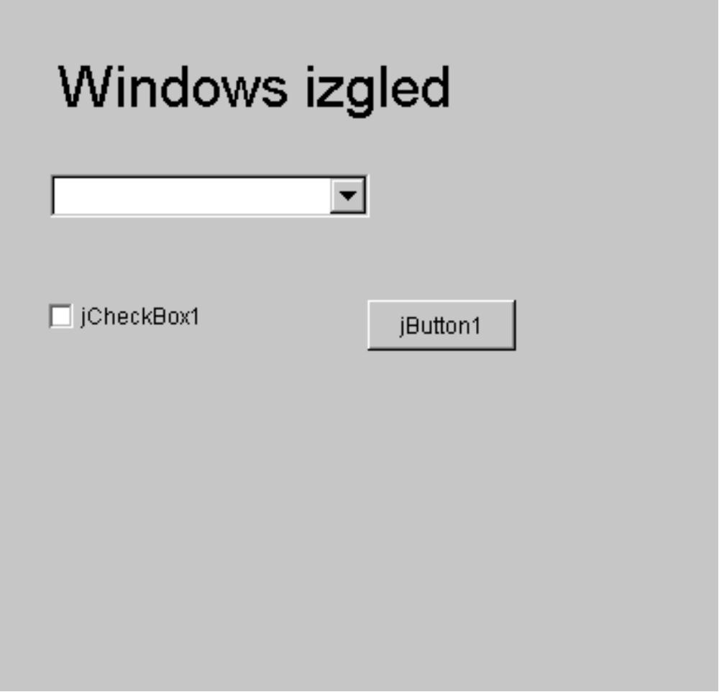
Swing - Windows
Programming I
© Branko Kavšek, Jernej Vičič
13

Slide 26
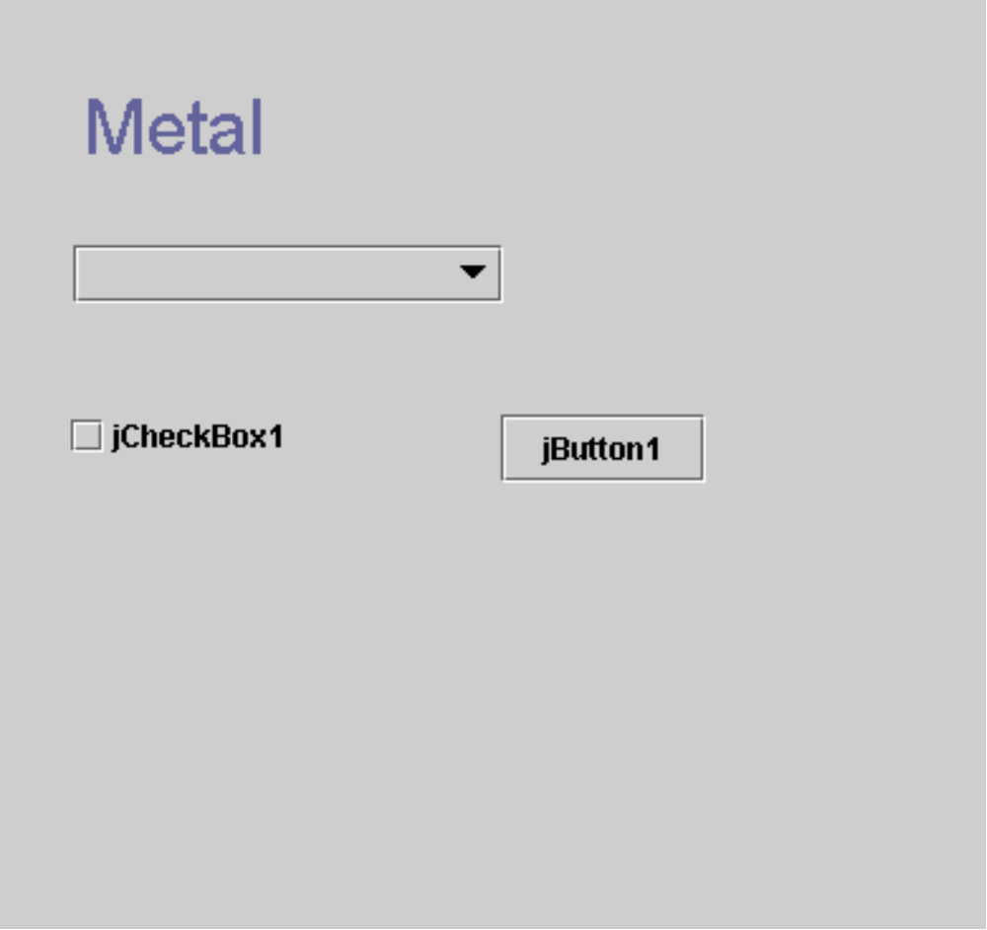
Swing metal (Java)
Programming I
© Branko Kavšek, Jernej Vičič
13

Slide 27
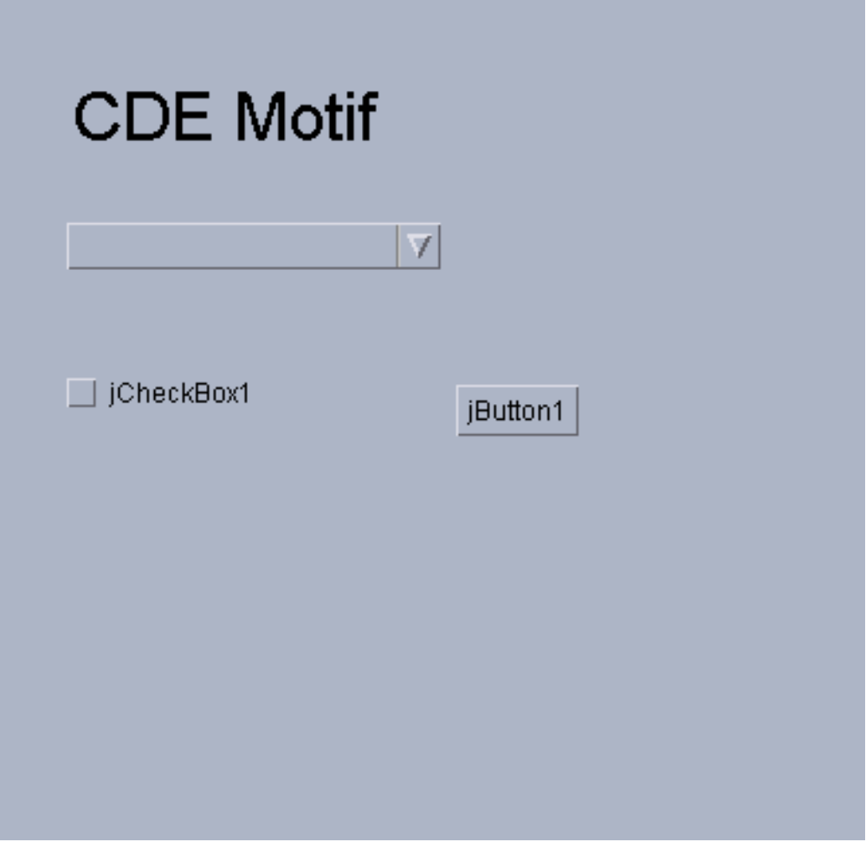
Swing Motif
Programming I
© Branko Kavšek, Jernej Vičič
13

